Slide 1
DATS 6103 Introduction to Data mining
Individual Project 1

Slide 2
objectives
Analyze the military spending of G-20 nations since 2006
Compare the military spending to the country’s GDP
Compare per person military spending to the per person GDP
Single out the fastest growing country in military spending

Slide 3
About the dataset
The data for military expenditure, military expenditure as a share of GDP and military expenditure per capita was downloaded from “Stockholm International Peace Research Institute”.
Source: https://www.sipri.org/databases/milex
The per person GDP data was collected from World Bank.
Source: https://knoema.com/atlas/ranks/GDP-per-capita

Slide 4
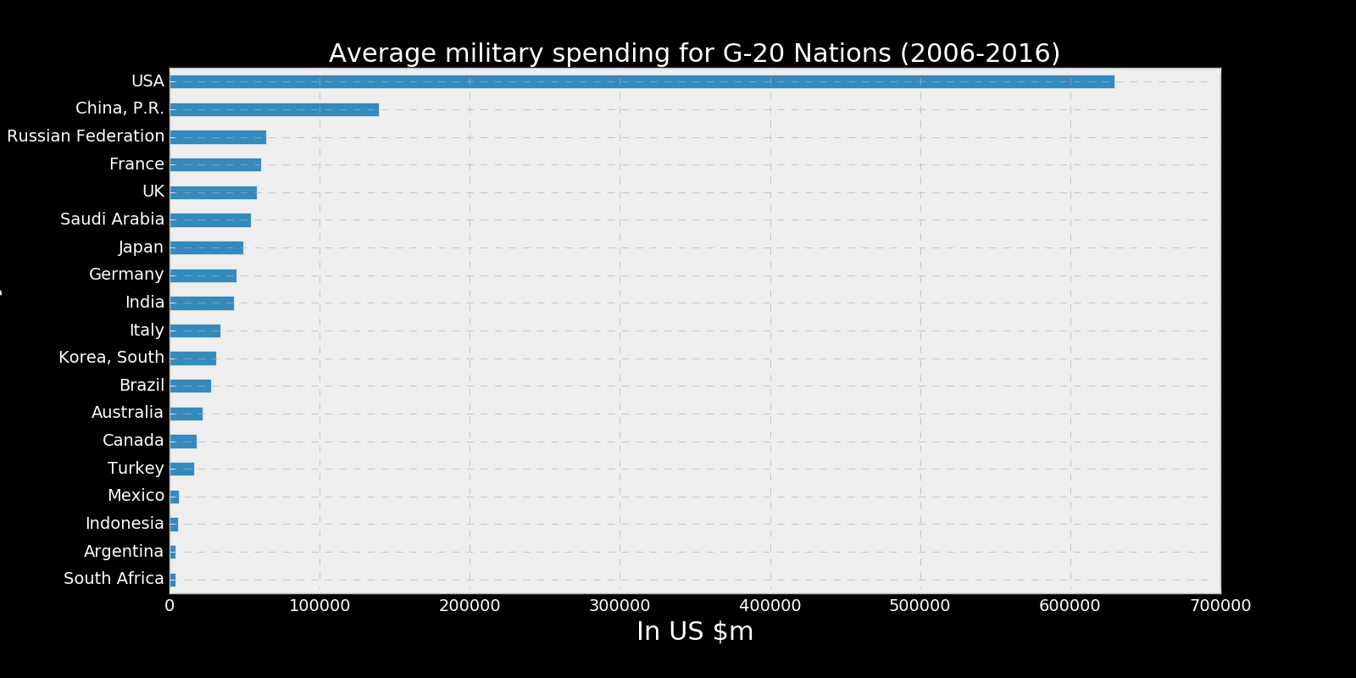
Overall military spending
USA spends the highest among the G-20 nations for military
USA spent around $629 billion for military on an average(2006-2016)

Slide 5
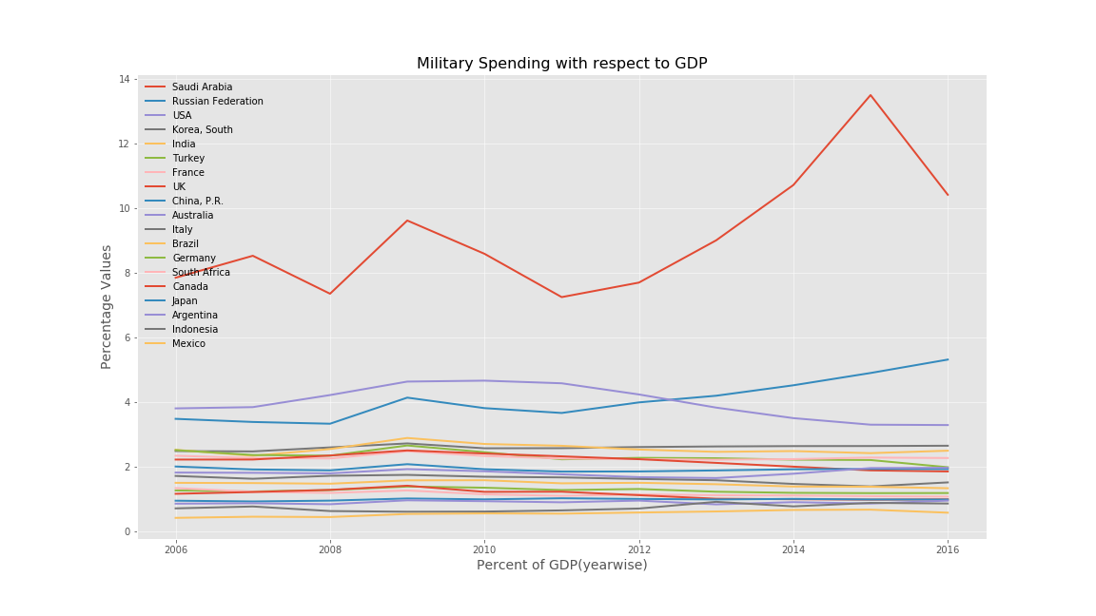
Military spending w.r.t GDP
Saudi Arabia tops the chart in this case.

Slide 6
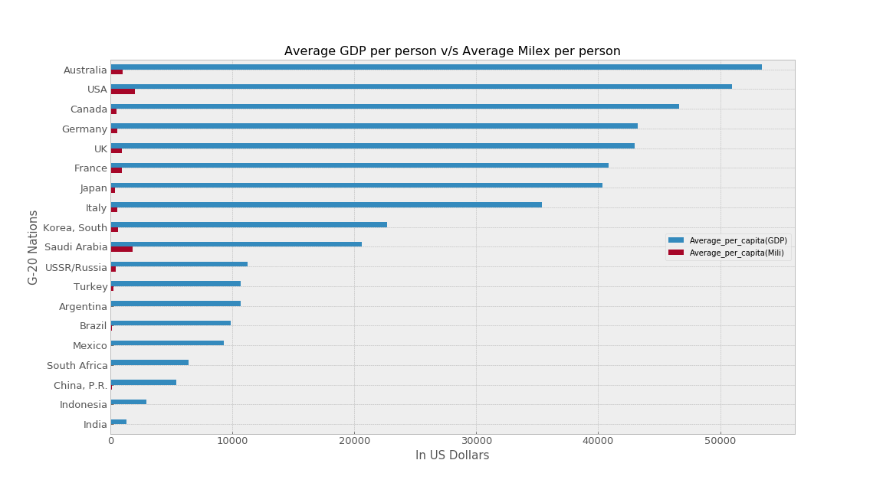
Per person military spending w.r.t per person GDP

Slide 7

Fastest Growing country in military spending
China is the fastest growing country in military spending

Slide 8
conclusion
USA spends the highest for military.
Saudi Arabia spends the most for military as a share of gdp. It may be because the GDP of Saudi Arabia is considerably low as compared to that of other countries.
Per capita military spending is high for USA and Saudi Arabia. The values are low for China and India because the population of those countries is very high as compared to rest of the nations.
China is the fastest growing country in terms of military spending. They have experienced an increase of 288% in military spending since 2006. The increase is over $150 billion.

Slide 9
Thank you

